Slide 1



Presentation on
TELECOM CHURN ANALYSIS
Turning Churn Data into Actionable Business Insights
26th April, 2025

Slide 2


PROBLEM STATEMENT
Customer churn remains a critical issue for Telecom companies, affecting revenue and customer lifetime value.
This analysis explores key drivers of churn to uncover actionable insights and guide retention strategies.

Slide 3

OBJECTIVES
Analyze the overall churn rate and explore reasons for customer churn.
Evaluate the impact of factors such as group contracts, international plans, etc on churn behavior.
Identify demographic and behavioral trends influencing churn.
Assess the impact of customer service interactions on churn.
Provide actionable insights to support churn reduction strategies.

Slide 4
DATA OVERVIEW
6687
4891
Total Number of Customers
Total Active Customers
26.86%
Customer Churn Rate
Over a quarter of the customer base has churned. This requires urgent attention.

Slide 5

ANALYSIS INSIGHTS

Slide 6
KEY INSIGHTS
1. Top Churn Reasons :
Most churns were due to competitor influence and dissatisfaction.
303
297
203
customers
customers
customers
4891
Network issues
Customer Service Support
Competitor Reason

Slide 7
KEY INSIGHTS
2. International Plan and Activeness:
71.19% churn
Intl Active Customers = yes, but no Intl Plan
7.59% churn
Intl Plan + Active: Only
4891
Those who frequently use international services are retained if subscribed to an international plan.

Slide 8
KEY INSIGHTS
3. Customer Support Calls
Average Calls Made by Customers
2.4 calls
0.37 calls
Churners
Retained

Slide 9



KEY INSIGHTS
4. Demographic Insights
Majority of churned customers are under 30 (youth).
33.02%
32.26%
34.72%
Female
Male
Prefer not to say

Slide 10

KEY INSIGHTS
4. Churn by Account Length
Customers with shorter account durations are more likely to churn.
7.7%
Peaks at
62%
Steadily declines after 10 months
Churn rate in first 5 months
Churn rate after 50 months

Slide 11

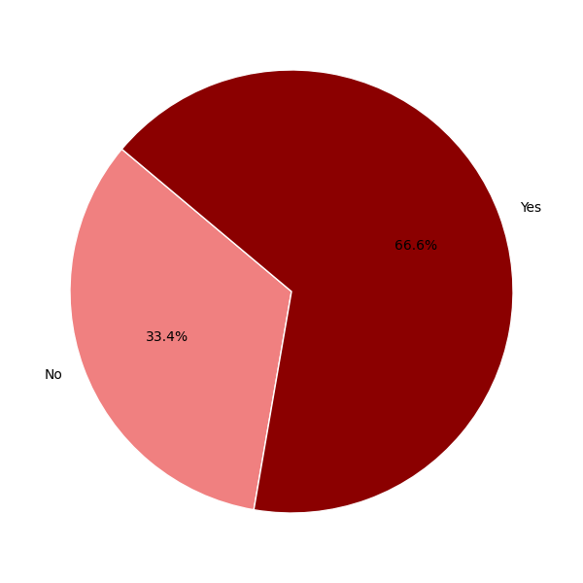
KEY INSIGHTS
5. Unlimited Data Plan
Customers with unlimited plans churn more.

Slide 12
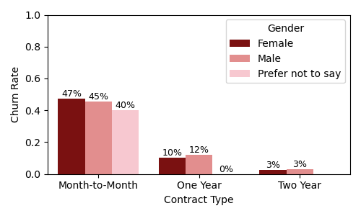
KEY INSIGHTS
6. Contract Type & Gender Impact
Churn is low among customers with long-term contracts, especially among females

Slide 13

KEY INSIGHTS
7. Group Affiliation & Age
Customers aged 50+ without group affiliation churn more than those in a group
36.39%
Customers in group contracts churn less.

Slide 14

RECOMMENDATIONS
Improve service quality and offer competitive pricing to address key churn reasons.
Encourage group contracts and optimize international offerings for high-risk users.
Use demographic and usage data to create targeted retention campaigns.
Train agents and monitor frequent callers to reduce churn triggered by poor service.
Use churn prediction models to engage and retain high-risk customers proactively.

Slide 15

https://customerchurng2.streamlit.app/
LET’S PREDICT WHICH CUSTOMERS MIGHT LEAVE
CODES:
https://github.com/Patrick-Ko/customer-churn

Slide 16

CONCLUSION
Churn rate stands at 26.86%, with most customers leaving voluntarily.
Over 70% of internationally active users without a plan churned.
Churned customers made 2.4 service calls on average vs. 0.37 for non-churners.
Group affiliation and long-term contracts reduce churn significantly.
Younger, high-data users are more prone to churn without targeted support.

Slide 17

THANK YOU

Slide 18





MEET OUR TEAM
INNA DIANA BOATENG
STEPHANIE COFFIE
PATRICK DOGBATSE
JESSICA OPOKU MENSAH
BLESS APPIAH-KUBI

